Slide 1

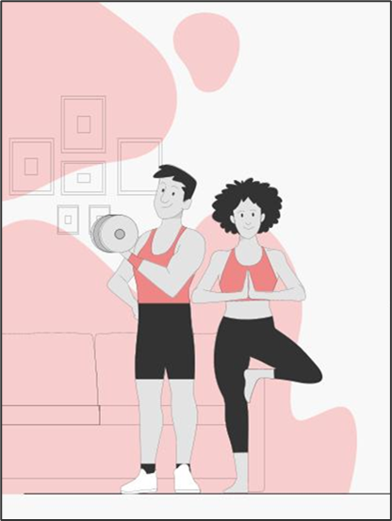
HUMAN ACTIVITY RECOGNITION
STAT- 4650 MACHINE LEARNING
Under the guidance of
Prof. Yue Gao
Final Project Presentation by
Veerasaimohit Dandu
Bargavi Kongara
Shailja Sharma
Srivalli Adigarla
Hrunay Shah

Slide 2
TABLE OF CONTENTS
01
02
03
04
Introduction
06
Data Analysis
Problem Statement
07
Predictive Models
Objectives
08
Performance Analysis
Data Description
09
Business Implications
05
Methodologies
10
Conclusion

Slide 3
INTRODUCTION
The need for understanding human activities is growing in healthcare, elder care support, rehabilitation assistance, diabetes and cognitive disorders.
Sensors can help caretakers record and monitor patients all the time and report automatically when any abnormal behavior is detected, saving resources.
Low-cost smartphones, smart watches used as sensors to identify human activities, taking advantage of the growing popularity and computational power of smartphones.
The system only uses readings from a 3-dimensional accelerometer as gyroscope is not easily accessible in cell-phones.
The constraints of attaching sensors to fixed body positions with fixed device orientation have been relaxed.
Other applications could be in security in surveillance camera, to mark and alarm suspicious objects or behavior.

Slide 4
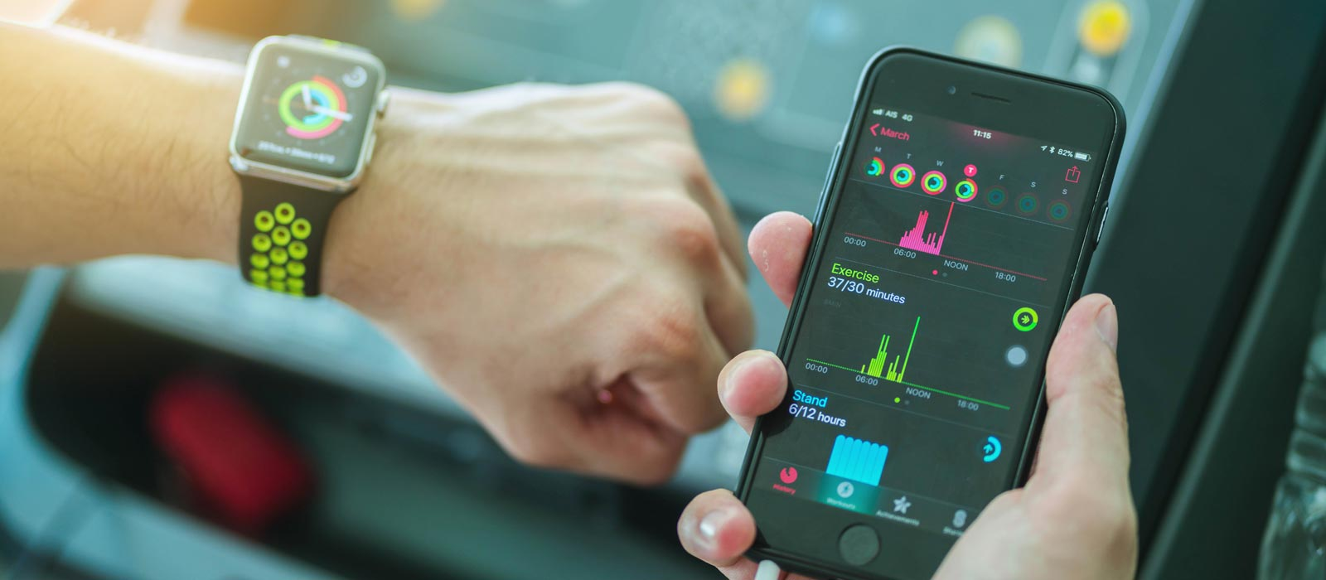
PROBLEM STATEMENT
The problem addressed in this project is the accurate recognition and classification of human activities using sensor data collected from wearable devices or other sources.
This is a challenging task due to the complexity and variability of human activities, as well as the noise and uncertainty inherent in sensor data.
The challenge arises as there is no explicit approach to deduce human actions from sensor information in a general manner.

Slide 5
OBJECTIVES
To develop a system that accurately identifies six different human activities using data from wearable sensors.
To create a classification model that can effectively differentiate between walking, walking upstairs, walking downstairs, sitting, standing and laying.
To pre-process sensor signals to obtain features from both the time and frequency domains.
To evaluate the performance of the developed system using a test dataset.

Slide 6
DATA DESCRIPTION
Data Source (CSV-format): https://www.kaggle.com/datasets/uciml/human-activity-recognition-with-smartphones
For each record in the dataset the following is provided:
Triaxial acceleration from the accelerometer (total acceleration) and the estimated body acceleration.
Triaxial Angular velocity from the gyroscope.
A 561-feature vector with time and frequency domain variables.
Its activity label.
An identifier of the subject who carried out the experiment.
Data Set Characteristics | Multivariate
Attribute Characteristics | Categorical, Integer, Real
Associated Tasks | Classification
Number of Instances | 10299
Number of Attributes | 563
Missing Values? Duplicates Found? | No & No

Slide 7
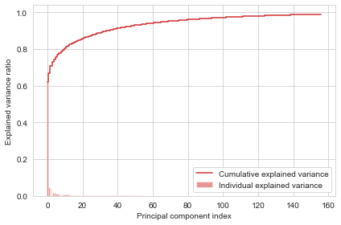
METHODOLOGIES
Data Cleaning – Checked for duplicates values, missing values, imbalance for our dataset.
EDA - Performed exploratory data analysis.
Pre-Processing – Principal Component Analysis (PCA) was performed to reduce the number of features to 157 from 561.

Slide 8
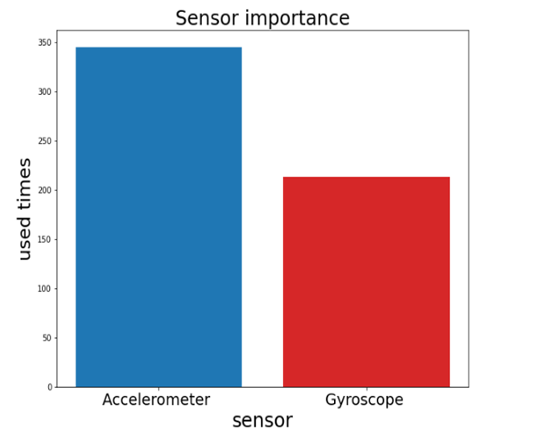
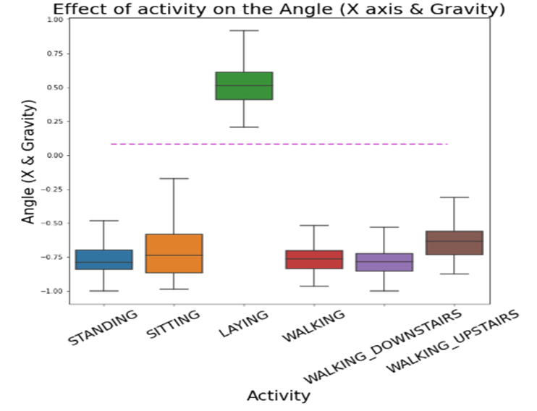
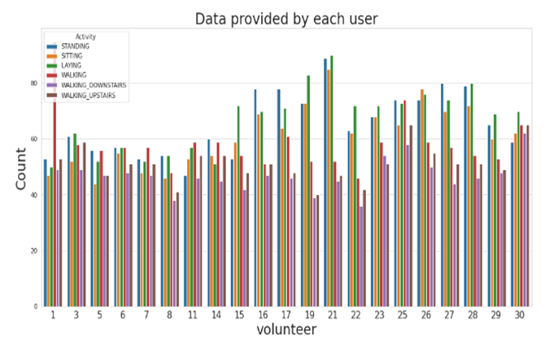
DESCRIPTIVE ANALYSIS
The most used sensor is accelerometer so we will focus on it in modeling
If angle(X,gravityMean) > 0 then Activity is Laying.
This graph shows the visualization of class distribution different activities by users.

Slide 9
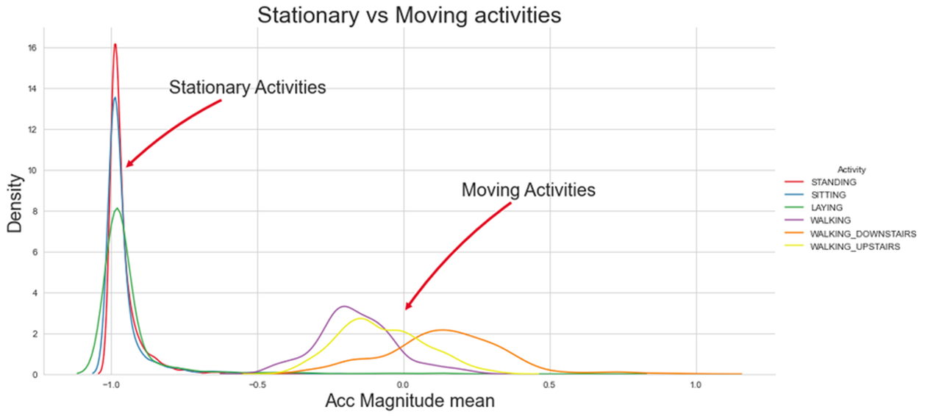
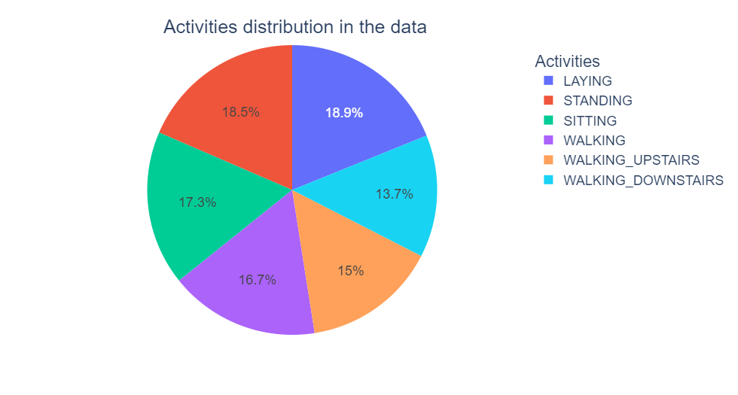
DESCRIPTIVE ANALYSIS
Visualizing distribution of Stationary and Moving activities tBodyAccMagmean feature itself is sufficient to distinguish Activities.
Number of data points per Activity : We have balanced data and will not do re-sampling.

Slide 10
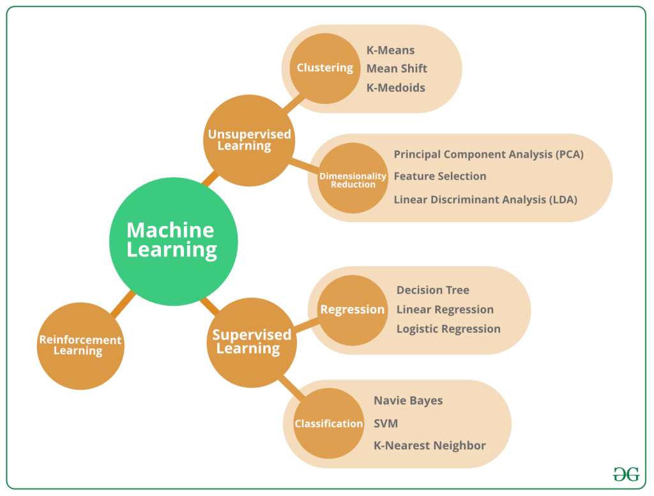
MODELS DEVELOPED
We have built the following Machine Learning models :
Logistic Regression
K Nearest Neighbor (KNN)
Naïve Bayes
Support Vector Machine
Decision Tree Method

Slide 11
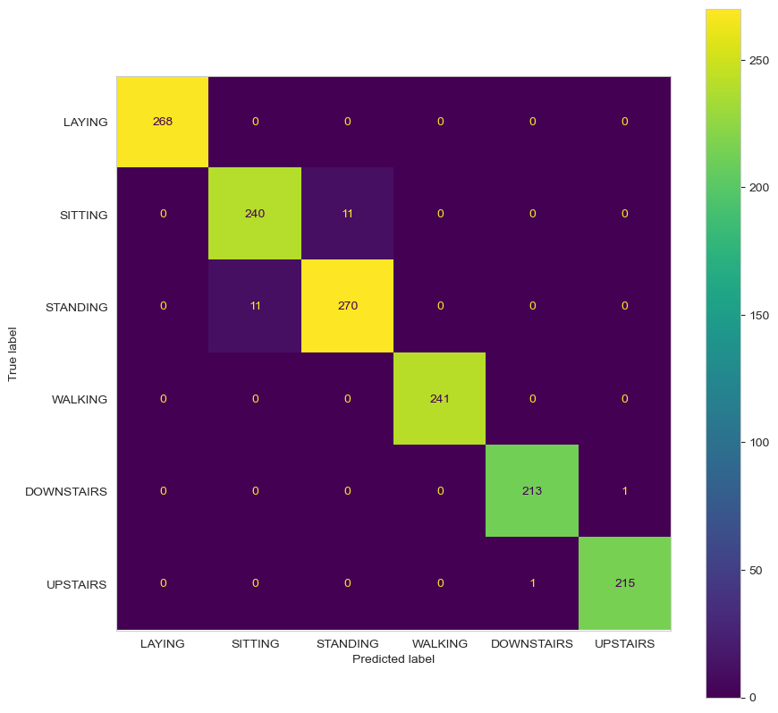
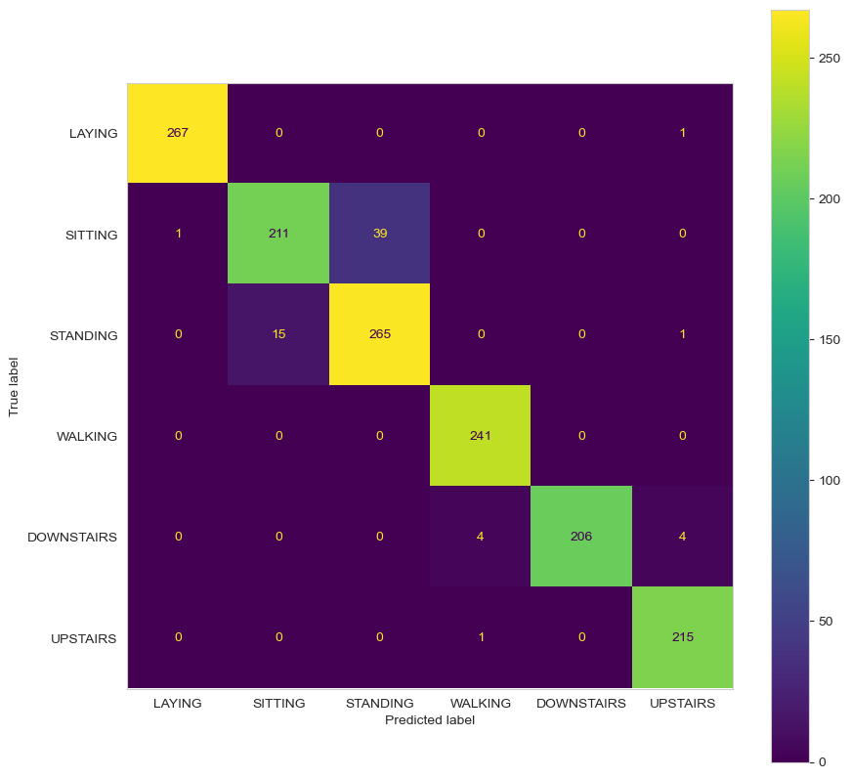
PREDICTIVE MODELS
Confusion Matrix of Logistic regression
Confusion Matrix of KNN

Slide 12
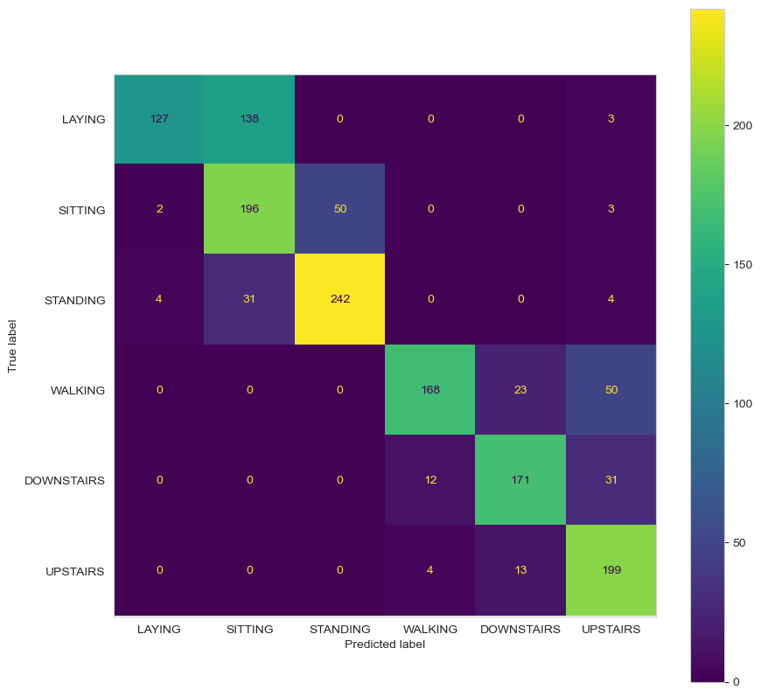

PREDICTIVE MODELS
Confusion Matrix of Naïve Bayes
Confusion Matrix of SVM

Slide 13
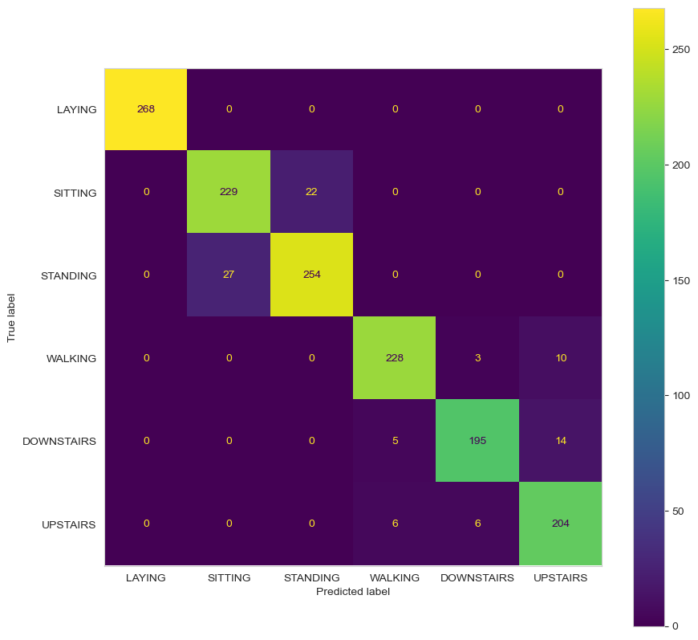
PREDICTIVE MODELS
Confusion Matrix of Decision Tree

Slide 14
PERFORMANCE ANALYSIS OF MODELS DEVELOPED
Model | Accuracy | Precision | Recall | F1 Score
Logistic Regression | 97.48% | 0.97 | 0.97 | 0.97
KNN | 95.03% | 0.95 | 0.95 | 0.95
Naïve Bayes | 74.98% | 0.74 | 0.74 | 0.74
SVM | 98.84% | 0.98 | 0.98 | 0.98
Decision Trees | 97.62% | 0.97 | 0.97 | 0.97

Slide 15
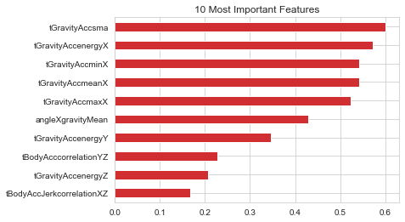
FINAL APPROACH SUMMARY
After evaluating several machine learning models for our classification problem, we have determined that the Support Vector Machine (SVM) model outperforms the other models.
Additionally, the SVM model had a higher F1-score of 0.98, indicating a better balance between precision and recall, compared to the other models.
These results demonstrate the effectiveness of the SVM model for our classification problem and we will use this model for future predictions. The SVM model provides a powerful tool for accurately classifying data and improving decision-making in our application.
Most Important features of SVM models were time
Gravity Accelerometer Signal magnitude area, Energy measure
in X Direction, Smallest value in X Direction.

Slide 16
BUSINESS IMPLICATIONS
This system could be used to monitor and analyze physical activity in elderly individuals to detect potential health risks or to improve sports performance by providing real-time feedback on technique & form.
This system could be used by healthcare professionals to make informed decisions based on the insights provided by the system, such as recommending specific exercises or activities for patients with certain medical conditions.
This algorithm can also be used to enhance virtual reality experiences by providing more immersive interactions between the user and the virtual environment.

Slide 17
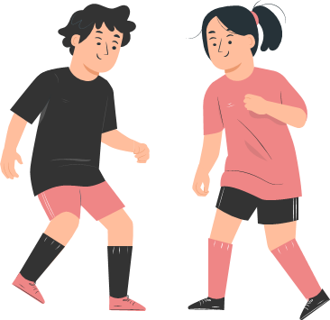
CONCLUSION
Human Activity Recognition has potential use cases in healthcare, sports and surveillance.
Sensor data can accurately classify human activities in real time.
Careful feature selection and model optimization are important for model performance and evaluation metrics should be chosen based on problem requirements.
HAR has opportunities for improving model performance and applications in the future and our study is a useful reference for researchers and practitioners.

Slide 18
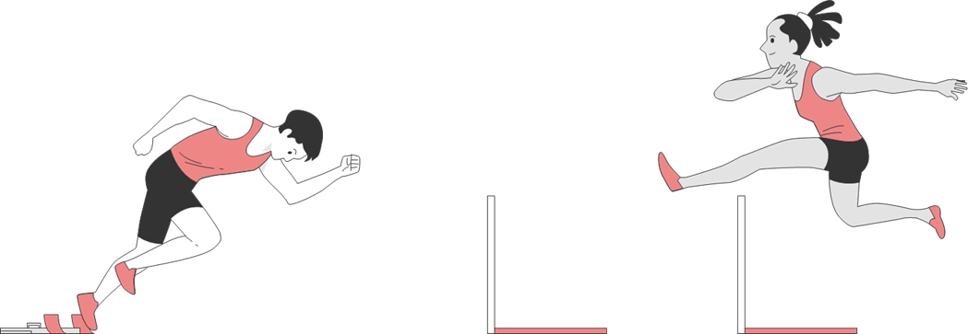
Thank you !

